Slide 1

Lattices
by
Dr. T. M. Rajalaxmi
Assistant Professor
Department of Mathematics

Slide 2
Remember
$If, a≤a∨b;a≤a∨c$ then $a≤\left(a∨b\right)∧(a∨b)$
$If, a∧b≤a;a∧c≤a$ then $\left(a∧b\right)∨\left(a∧c\right)≤a$

Slide 3

Isotonic Property
Let (L, $∧, ∨$) be given lattice. For any $a, b, c∈L,$we have,
If $b≤c⟹$
$a∧b≤a∧c$
and
$a∨b≤a∨c$

Slide 4

Isotonic Property
Proof: Given $b≤c$
Therefore $b∧c=b; −−−−−\left(1\right) b∨c=c−−−−−(2)$
Claim – 1: $a∧b≤a∧c$ $−−−−(3)$

Slide 5
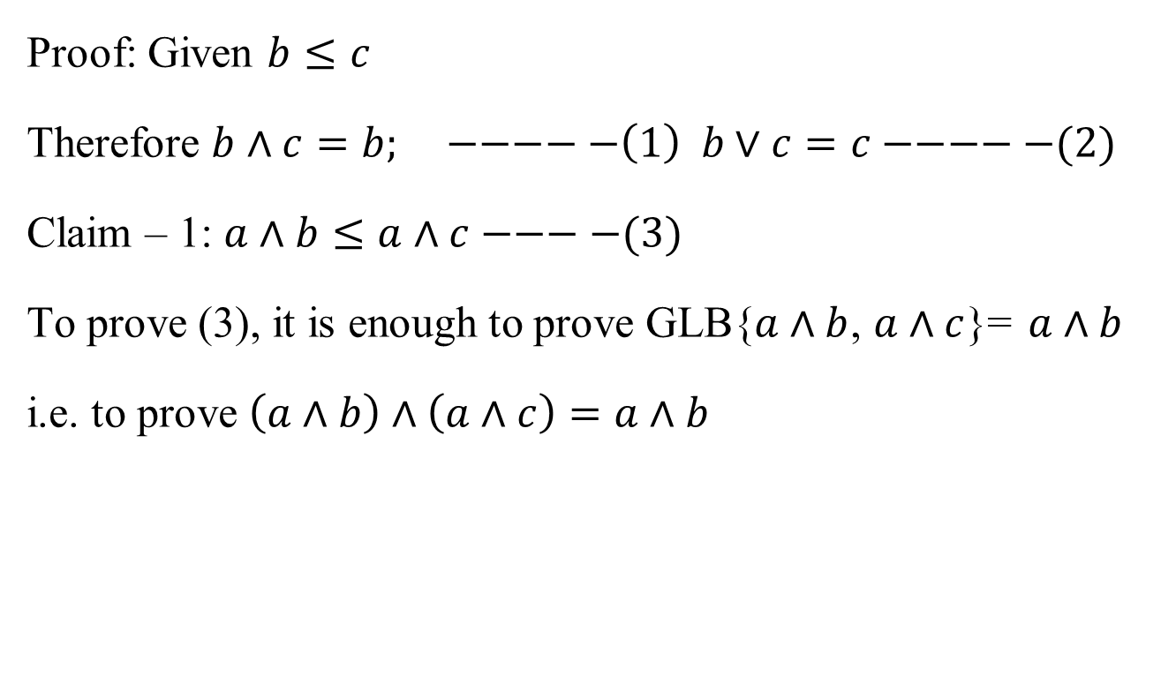
Isotonic Property
Proof: Given $b≤c$
Therefore $b∧c=b; −−−−−\left(1\right) b∨c=c−−−−−(2)$
Claim – 1: $a∧b≤a∧c−−−−(3)$
To prove (3), it is enough to prove GLB{$a∧b$, $a∧c$}= $a∧b$
i.e. to prove $\left(a∧b\right)∧\left(a∧c\right)=a∧b$

Slide 6
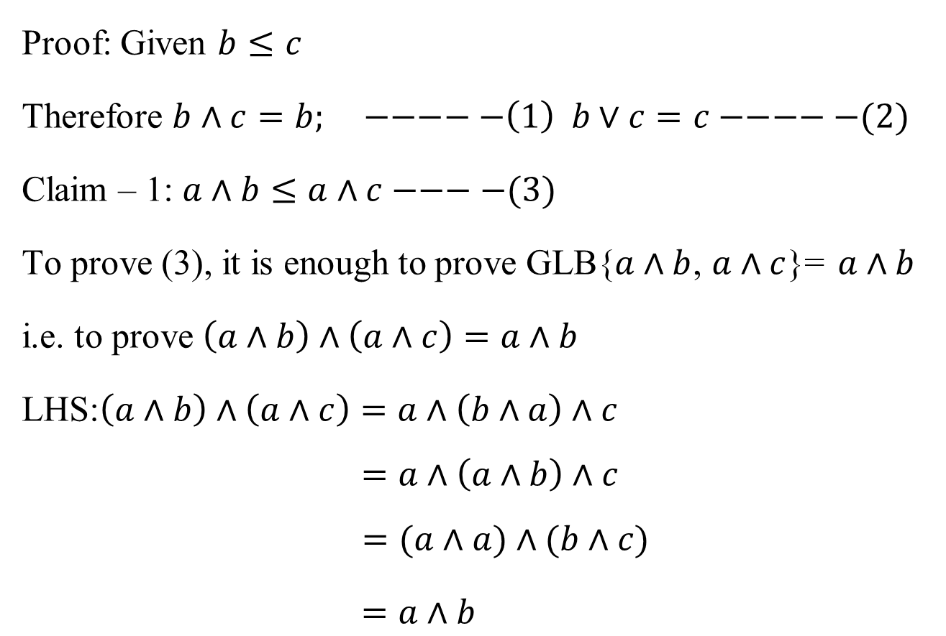
Isotonic Property
Proof: Given $b≤c$
Therefore $b∧c=b; −−−−−\left(1\right) b∨c=c−−−−−(2)$
Claim – 1: $a∧b≤a∧c−−−−(3)$
To prove (3), it is enough to prove GLB{$a∧b$, $a∧c$}= $a∧b$
i.e. to prove $\left(a∧b\right)∧\left(a∧c\right)=a∧b$
LHS:$\left(a∧b\right)∧\left(a∧c\right)=a∧\left(b∧a\right)∧c$
$$=a∧\left(a∧b\right)∧c$$
$$=(a∧a)∧(b∧c)$$
$=a∧b$

Slide 7

Isotonic Property
Claim – 2: $a∨b≤a∨c−−−−(4)$

Slide 8

Isotonic Property
Claim – 2: $a∨b≤a∨c−−−−(4)$
To prove (4), it is enough to prove LUB{$a∨b$, $a∨c$}= $a∨c$
i.e. to prove $\left(a∨b\right)∨\left(a∨c\right)=a∨c$

Slide 9
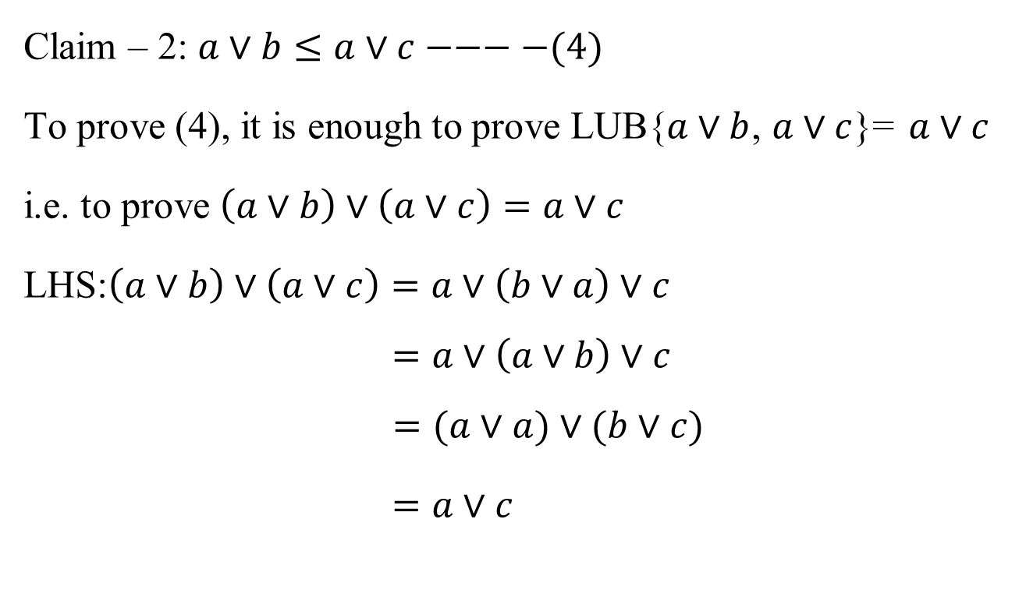
Isotonic Property
Claim – 2: $a∨b≤a∨c−−−−(4)$
To prove (4), it is enough to prove LUB{$a∨b$, $a∨c$}= $a∨c$
i.e. to prove $\left(a∨b\right)∨\left(a∨c\right)=a∨c$
LHS:$\left(a∨b\right)∨\left(a∨c\right)=a∨\left(b∨a\right)∨c$
$$=a∨\left(a∨b\right)∨c$$
$$=(a∨a)∨(b∨c)$$
$=a∨c$

Slide 10
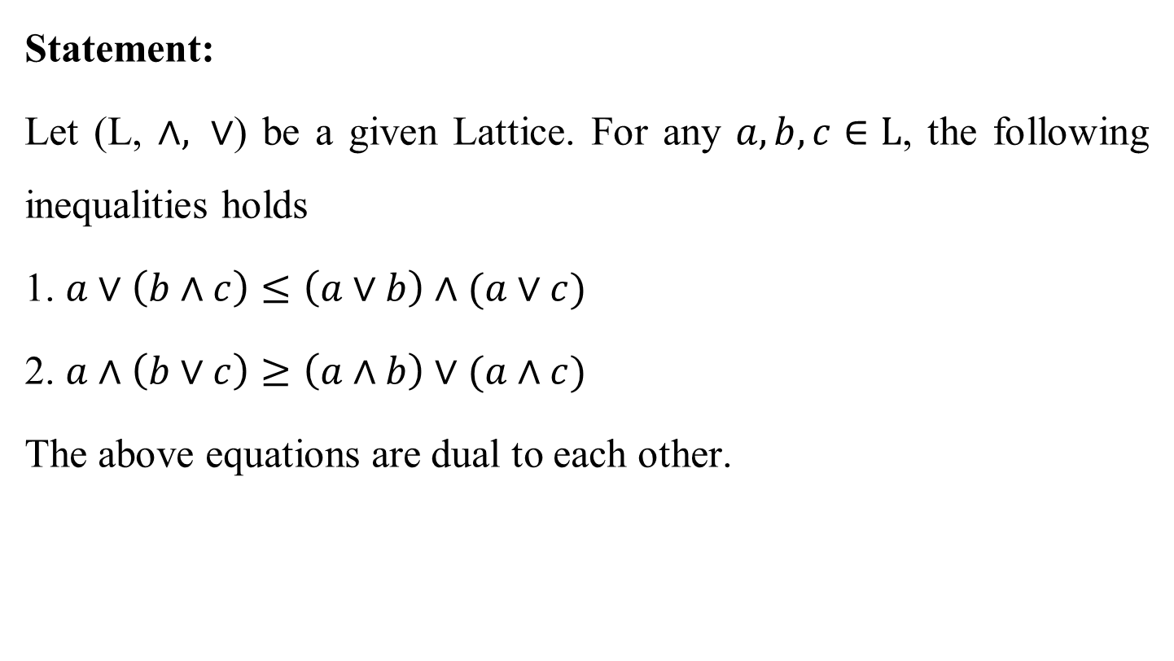
Distributive inequality
Statement:
Let (L, $∧, ∨$) be a given Lattice. For any $a, b, c∈L$, the following inequalities holds
1. $a∨\left(b∧c\right)≤\left(a∨b\right)∧(a∨c)$
2. $a∧\left(b∨c\right)≥\left(a∧b\right)∨(a∧c)$
The above equations are dual to each other.

Slide 11

Distributive Inequalities
Proof: Claim – 1:
$$a∨\left(b∧c\right)≤\left(a∨b\right)∧(a∨c)$$
From the definition of LUB, it is obvious that
$a≤a∨b$ -------(1)

Slide 12

Distributive Inequalities
Proof: Claim – 1:
$$a∨\left(b∧c\right)≤\left(a∨b\right)∧(a∨c)$$
From the definition of LUB, it is obvious that
$a≤a∨b$ -------(1)
and$b∧c≤b$
$≤a∨b$
$⟹b∧c≤a∨b$--------(2)

Slide 13

Distributive Inequalities
Proof: Claim – 1:
$$a∨\left(b∧c\right)≤\left(a∨b\right)∧(a∨c)$$
From the definition of LUB, it is obvious that
$a≤a∨b$ -------(1)
and$b∧c≤b$
$≤a∨b$
$⟹b∧c≤a∨b$--------(2)
From (1) and (2) $a∨b$ is an upper bound of {$a, b∧c$}.

Slide 14

Distributive Inequalities
Proof: Claim – 1:
$$a∨\left(b∧c\right)≤\left(a∨b\right)∧(a∨c)$$
From the definition of LUB, it is obvious that
$a≤a∨b$ -------(1)
and$b∧c≤b$
$≤a∨b$
$⟹b∧c≤a∨b$--------(2)
From (1) and (2) $a∨b$ is an upper bound of {$a, b∧c$}.
Hence $a∨\left(b∧c\right)≤a∨b$-------------------------------(A)

Slide 15

Distributive Inequalities
From the definition of LUB, it is obvious that
$a≤a∨c$ -------(3)

Slide 16

Distributive Inequalities
From the definition of LUB, it is obvious that
$a≤a∨c$ -------(3)
and$b∧c≤c$
$≤a∨c$
$⟹b∧c≤a∨c$--------(4)
From (3) and (4) $a∨c$ is an upper bound of {$a, b∧c$}.

Slide 17

Distributive Inequalities
From the definition of LUB, it is obvious that
$a≤a∨c$ -------(3)
and$b∧c≤c$
$≤a∨c$
$⟹b∧c≤a∨c$--------(4)
From (3) and (4) $a∨c$ is an upper bound of {$a, b∧c$}.
Hence $a∨\left(b∧c\right)≤a∨c$-------------------------------(B)

Slide 18
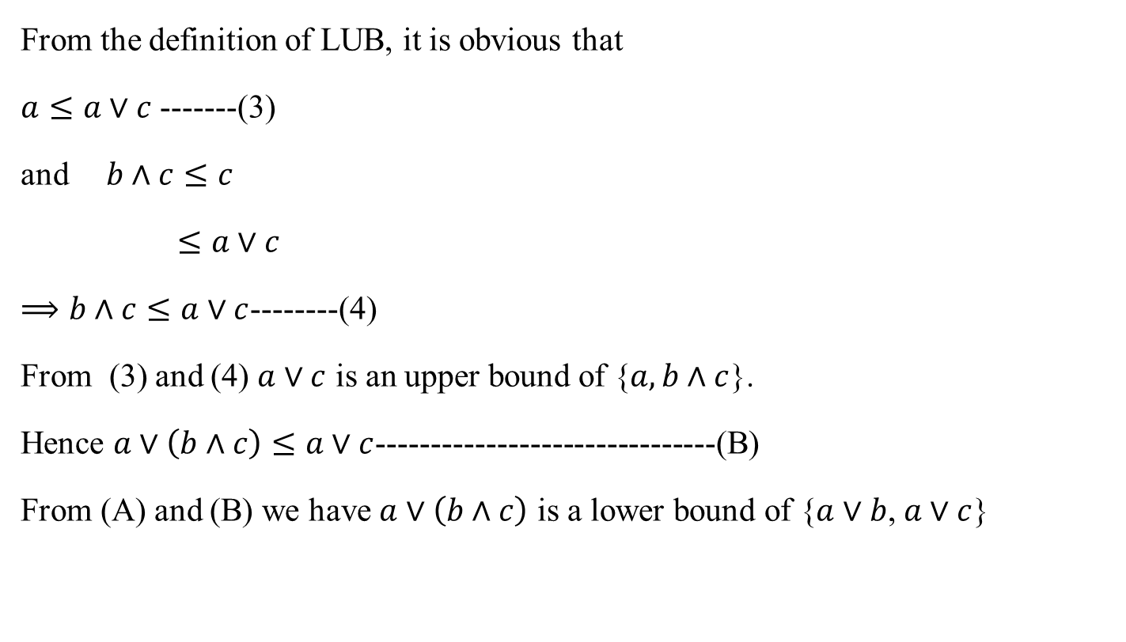
Distributive Inequalities
From the definition of LUB, it is obvious that
$a≤a∨c$ -------(3)
and$b∧c≤c$
$≤a∨c$
$⟹b∧c≤a∨c$--------(4)
From (3) and (4) $a∨c$ is an upper bound of {$a, b∧c$}.
Hence $a∨\left(b∧c\right)≤a∨c$-------------------------------(B)
From (A) and (B) we have $a∨\left(b∧c\right)$ is a lower bound of {$a∨b$, $a∨c$}

Slide 19
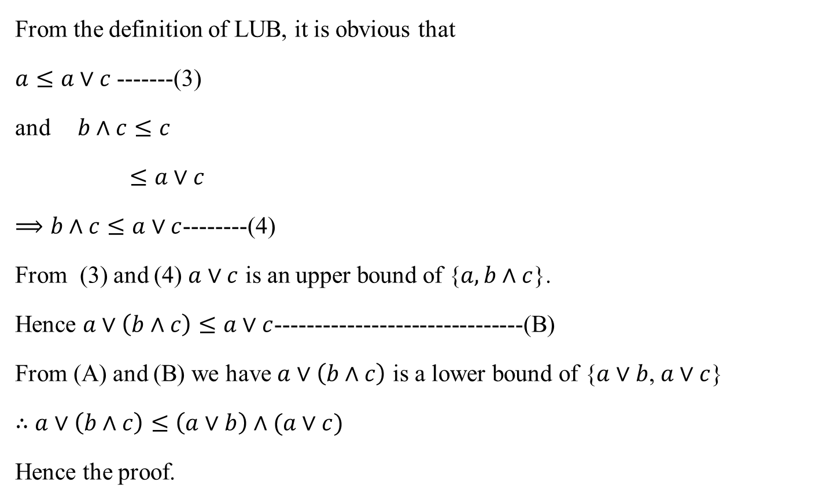
Distributive Inequalities
From the definition of LUB, it is obvious that
$a≤a∨c$ -------(3)
and$b∧c≤c$
$≤a∨c$
$⟹b∧c≤a∨c$--------(4)
From (3) and (4) $a∨c$ is an upper bound of {$a, b∧c$}.
Hence $a∨\left(b∧c\right)≤a∨c$-------------------------------(B)
From (A) and (B) we have $a∨\left(b∧c\right)$ is a lower bound of {$a∨b$, $a∨c$}
$∴$ $a∨\left(b∧c\right)≤\left(a∨b\right)∧(a∨c)$
Hence the proof.

Slide 20

Distributive Inequalities
Proof: Claim – 2:
$$a∧\left(b∨c\right)≥\left(a∧b\right)∨(a∧c)$$

Slide 21

Distributive Inequalities
Proof: Claim – 2:
$$a∧\left(b∨c\right)≥\left(a∧b\right)∨(a∧c)$$
From the definition of GLB, it is obvious that
$a≥a∧b$ -------(1)

Slide 22

Distributive Inequalities
Proof: Claim – 2:
$$a∧\left(b∨c\right)≥\left(a∧b\right)∨(a∧c)$$
From the definition of GLB, it is obvious that
$a≥a∧b$ -------(1)
and$b∨c≥b$
$≥a∧b$
$⟹b∨c≥a∧b$--------(2)

Slide 23

Distributive Inequalities
Proof: Claim – 2:
$$a∧\left(b∨c\right)≥\left(a∧b\right)∨(a∧c)$$
From the definition of GLB, it is obvious that
$a∧b≤a$ -------(1)
and$b∨c≥b$
$≥a∧b$
$⟹a∧b≤b∨c$--------(2)
From (1) and (2) $a∧b$ is an lower bound of {$a, b∨c$}.
Hence $a∧b≤a∧\left(b∨c\right)$-------------------------------(C)

Slide 24

Distributive Inequalities
From the definition of GLB, it is obvious that
$a∧c≤a$ -------(3)

Slide 25

Distributive Inequalities
From the definition of GLB, it is obvious that
$a∧c≤a$ -------(3)
and$b∨c≥c$
$≥a∧c$
$⟹a∧c≤b∨c$--------(4)

Slide 26

Distributive Inequalities
From the definition of GLB, it is obvious that
$a∧c≤a$ -------(3)
and$b∨c≥c$
$≥a∧c$
$⟹a∧c≤b∨c$--------(4)
From (3) and (4) $a∧c$ is an lower bound of {$a, b∨c$}.
Hence $a∧c≤a∧\left(b∨c\right)$-------------------------------(D)

Slide 27
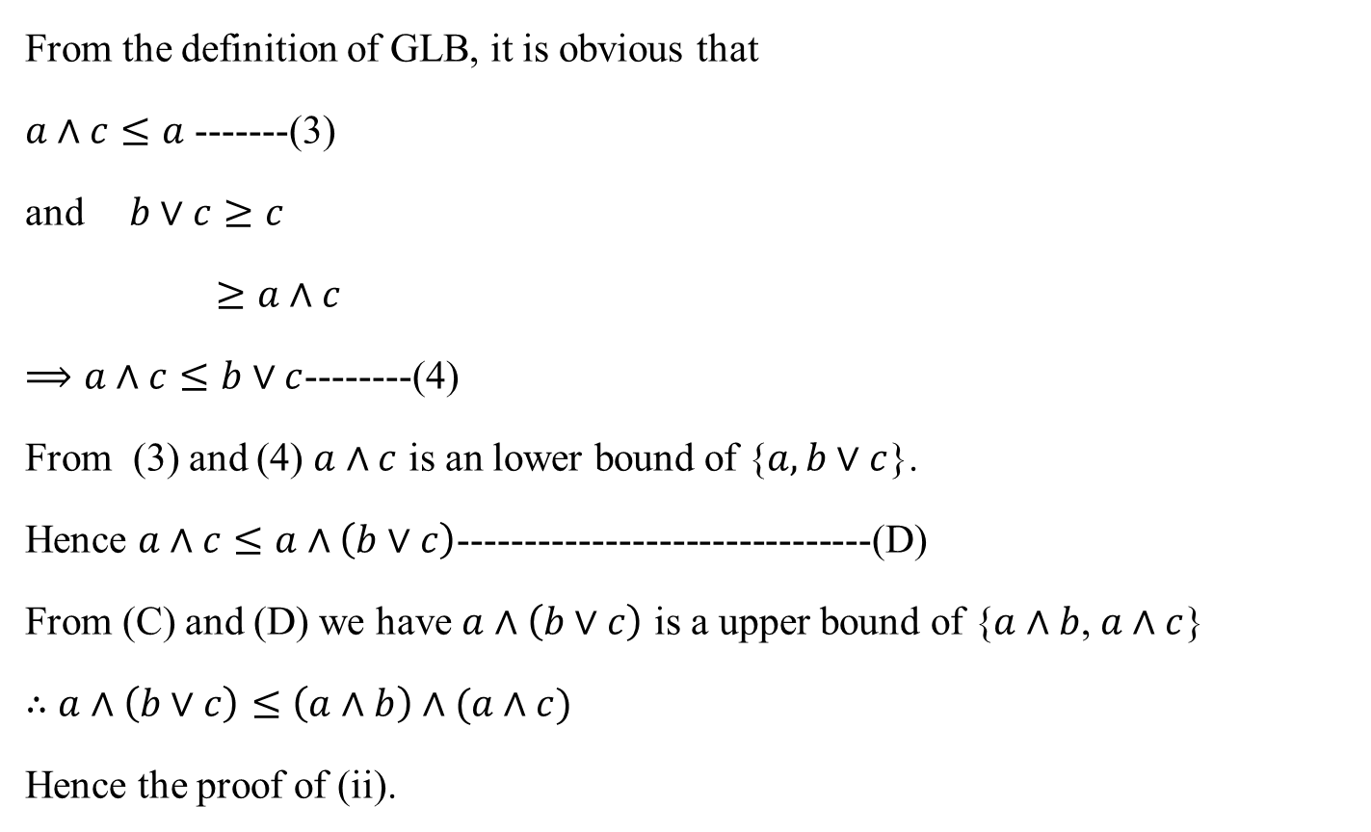
Distributive Inequalities
From the definition of GLB, it is obvious that
$a∧c≤a$ -------(3)
and$b∨c≥c$
$≥a∧c$
$⟹a∧c≤b∨c$--------(4)
From (3) and (4) $a∧c$ is an lower bound of {$a, b∨c$}.
Hence $a∧c≤a∧\left(b∨c\right)$-------------------------------(D)
From (C) and (D) we have $a∧\left(b∨c\right)$ is a upper bound of {$a∧b$, $a∧c$}
$∴$ $a∧\left(b∨c\right)≤\left(a∧b\right)∧(a∧c)$
Hence the proof of (ii).

Slide 28

Distributive Lattice
A Lattice (L, $∧, ∨$) is said to be distributive Lattice if $∧$ and $∨$ satisfies the following conditions. $∀ a, b, c∈L$,
1. $a∨\left(b∧c\right)=\left(a∨b\right)∧(a∨c)$
2. $a∧\left(b∨c\right)=\left(a∧b\right)∨(a∧c)$

Slide 29

Distributive Lattice
Example:
Show that the given lattice is distributive lattice
It is enough to prove that either 1st equation or 2nd equation.
LHS: $a∨\left(b∧c\right)$
1
a
b
c
0

Slide 30

Distributive Lattice
Example:
Need to show that the given lattice is distributive lattice
It is enough to prove that either 1st equation or 2nd equation.
LHS: $a∨\left(b∧c\right)=a∨0=a$
1
a
b
c
0

Slide 31

Distributive Lattice
Example:
Need to show that the given lattice is distributive lattice
It is enough to prove that either 1st equation or 2nd equation.
LHS: $a∨\left(b∧c\right)=a∨0=a$
But RHS: $\left(a∨b\right)∧(a∨c)$
1
a
b
c
0

Slide 32

Distributive Lattice
Example:
Need to show that the given lattice is distributive lattice
It is enough to prove that either 1st equation or 2nd equation.
LHS: $a∨\left(b∧c\right)=a∨0=a$
But RHS: $\left(a∨b\right)∧\left(a∨c\right)=1∧1=1$
1
a
b
c
0

Slide 33
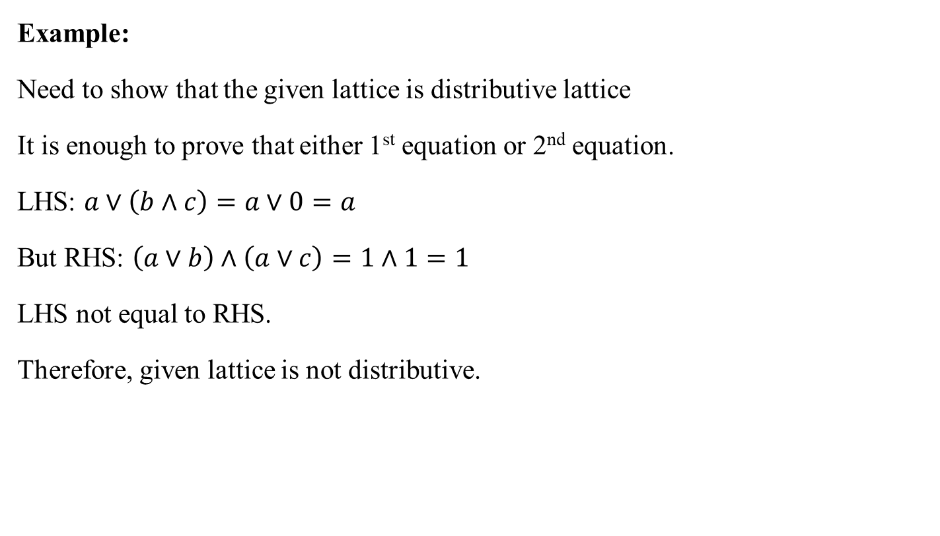
Distributive Lattice
Example:
Need to show that the given lattice is distributive lattice
It is enough to prove that either 1st equation or 2nd equation.
LHS: $a∨\left(b∧c\right)=a∨0=a$
But RHS: $\left(a∨b\right)∧\left(a∨c\right)=1∧1=1$
LHS not equal to RHS.
Therefore, given lattice is not distributive.
1
a
b
c
0

Slide 34
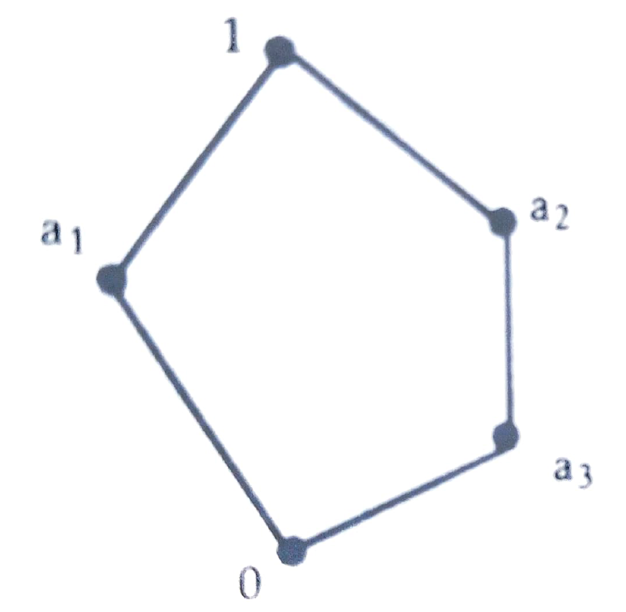
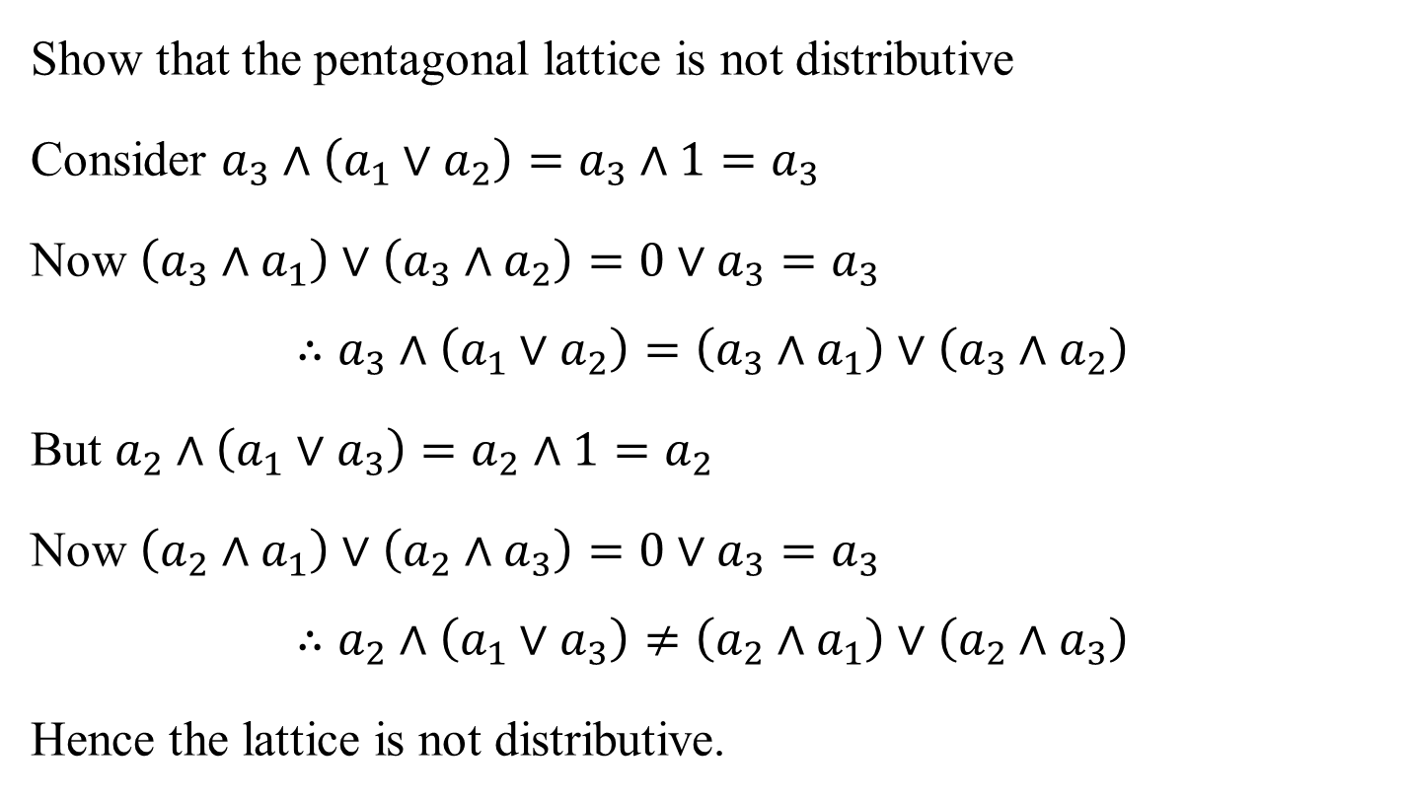
Distributive Lattice
Show that the pentagonal lattice is not distributive
Consider $a_{3}∧\left(a_{1}∨a_{2}\right)=a_{3}∧1=a_{3}$
Now $\left(a_{3}∧a_{1}\right)∨\left(a_{3}∧a_{2}\right)=0∨a_{3}=a_{3}$
$$∴a_{3}∧\left(a_{1}∨a_{2}\right)=\left(a_{3}∧a_{1}\right)∨\left(a_{3}∧a_{2}\right)$$
But $a_{2}∧\left(a_{1}∨a_{3}\right)=a_{2}∧1=a_{2}$
Now $\left(a_{2}∧a_{1}\right)∨\left(a_{2}∧a_{3}\right)=0∨a_{3}=a_{3}$
$$∴a_{2}∧\left(a_{1}∨a_{3}\right)≠\left(a_{2}∧a_{1}\right)∨\left(a_{2}∧a_{3}\right)$$
Hence the lattice is not distributive.

Slide 35

Modular Inequality
If (L, $∧, ∨$) is a Lattice, then for any $a, b, c∈L$,
$$a≤c⟺a∨\left(b∧c\right)≤\left(a∨b\right)∧c$$

Slide 36

Modular Inequality
If (L, $∧, ∨$) is a Lattice, then for any $a, b, c∈L$,
$$a≤c⟺a∨\left(b∧c\right)≤\left(a∨b\right)∧c$$
Proof: Given $a≤c$

Slide 37

Modular Inequality
If (L, $∧, ∨$) is a Lattice, then for any $a, b, c∈L$,
$$a≤c⟺a∨\left(b∧c\right)≤\left(a∨b\right)∧c$$
Proof: Given $a≤c$
$⟹a∨c=c$ -------------------------------------------(1)

Slide 38

Modular Inequality
If (L, $∧, ∨$) is a Lattice, then for any $a, b, c∈L$,
$$a≤c⟺a∨\left(b∧c\right)≤\left(a∨b\right)∧c$$
Proof: Given $a≤c$
$⟹a∨c=c$ -------------------------------------------(1)
by distributive inequality, we have
$$a∨\left(b∧c\right)≤\left(a∨b\right)∧(a∨c)$$

Slide 39

Modular Inequality
If (L, $∧, ∨$) is a Lattice, then for any $a, b, c∈L$,
$$a≤c⟺a∨\left(b∧c\right)≤\left(a∨b\right)∧c$$
Proof: Given $a≤c$
$⟹a∨c=c$ -------------------------------------------(1)
by distributive inequality, we have
$$a∨\left(b∧c\right)≤\left(a∨b\right)∧\left(a∨c\right)$$
$≤\left(a∨b\right)∧c$ using (1)

Slide 40
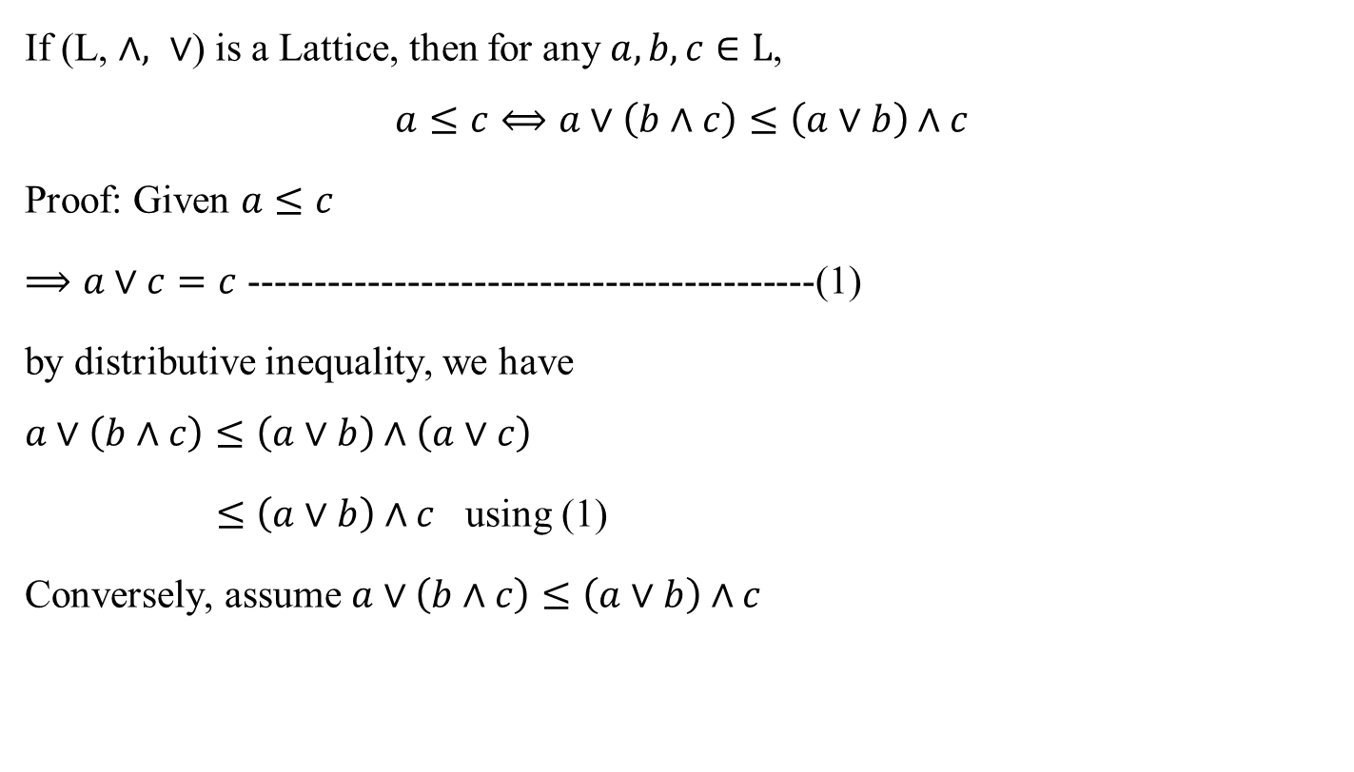
Modular Inequality
If (L, $∧, ∨$) is a Lattice, then for any $a, b, c∈L$,
$$a≤c⟺a∨\left(b∧c\right)≤\left(a∨b\right)∧c$$
Proof: Given $a≤c$
$⟹a∨c=c$ -------------------------------------------(1)
by distributive inequality, we have
$$a∨\left(b∧c\right)≤\left(a∨b\right)∧\left(a∨c\right)$$
$≤\left(a∨b\right)∧c$ using (1)
Conversely, assume $a∨\left(b∧c\right)≤\left(a∨b\right)∧c$

Slide 41
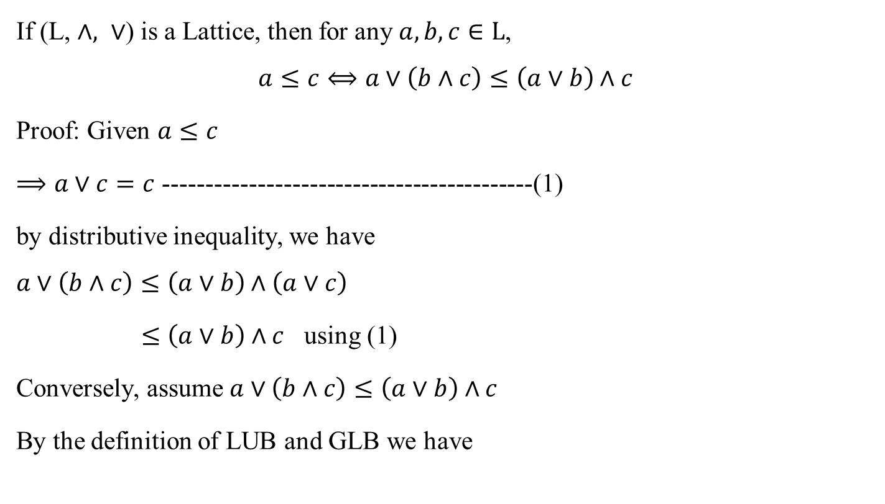
Modular Inequality
If (L, $∧, ∨$) is a Lattice, then for any $a, b, c∈L$,
$$a≤c⟺a∨\left(b∧c\right)≤\left(a∨b\right)∧c$$
Proof: Given $a≤c$
$⟹a∨c=c$ -------------------------------------------(1)
by distributive inequality, we have
$$a∨\left(b∧c\right)≤\left(a∨b\right)∧\left(a∨c\right)$$
$≤\left(a∨b\right)∧c$ using (1)
Conversely, assume $a∨\left(b∧c\right)≤\left(a∨b\right)∧c$
By the definition of LUB and GLB we have

Slide 42
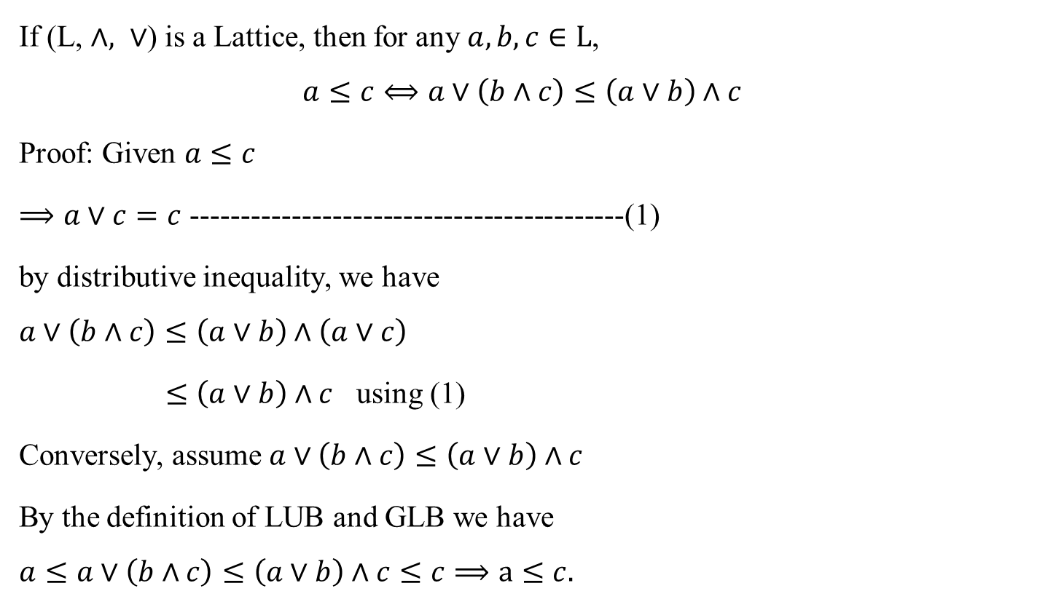
Modular Inequality
If (L, $∧, ∨$) is a Lattice, then for any $a, b, c∈L$,
$$a≤c⟺a∨\left(b∧c\right)≤\left(a∨b\right)∧c$$
Proof: Given $a≤c$
$⟹a∨c=c$ -------------------------------------------(1)
by distributive inequality, we have
$$a∨\left(b∧c\right)≤\left(a∨b\right)∧\left(a∨c\right)$$
$≤\left(a∨b\right)∧c$ using (1)
Conversely, assume $a∨\left(b∧c\right)≤\left(a∨b\right)∧c$
By the definition of LUB and GLB we have
$$a≤a∨\left(b∧c\right)≤\left(a∨b\right)∧c≤c⟹a≤c.$$

Slide 43

Modular Lattice
A Lattice (L, $∧, ∨$) is said to be Modular Lattice if it satisfies the following condition
If $a≤c then a∨\left(b∧c\right)=\left(a∨b\right)∧c ∀ a, b, c∈L$,

Slide 44
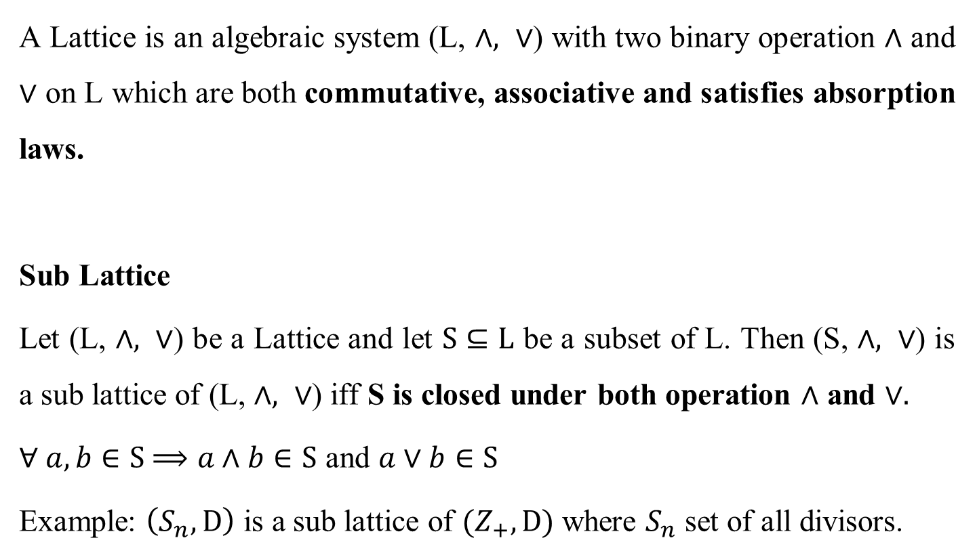
Lattice as an algebraic system
A Lattice is an algebraic system (L, $∧, ∨$) with two binary operation $∧$ and $∨$ on L which are both commutative, associative and satisfies absorption laws.
Sub Lattice
Let (L, $∧, ∨$) be a Lattice and let $S⊆L$ be a subset of L. Then (S, $∧, ∨$) is a sub lattice of (L, $∧, ∨$) iff S is closed under both operation $∧$ and $∨.$
$∀ a, b∈S$ $⟹a∧b∈S$ and $a∨b∈S$
Example: $\left(S_{n}, D\right)$ is a sub lattice of $(Z_{+}, D)$ where $S_{n}$ set of all divisors.

Slide 45
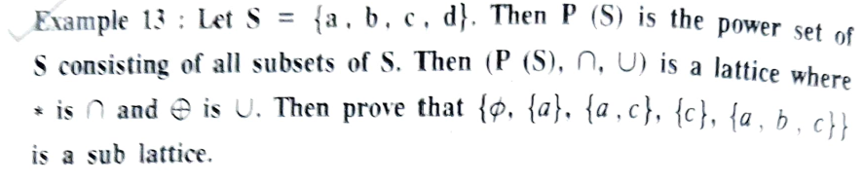
Sublattice - Example

Slide 46
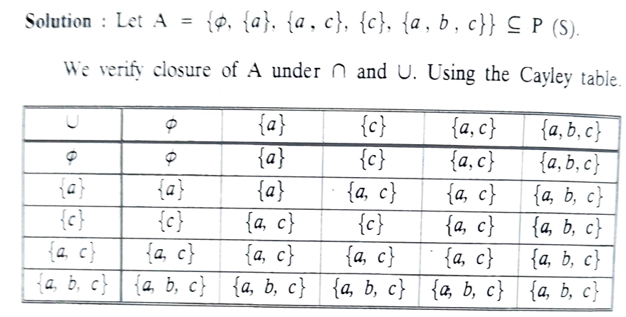
Sublattice - Example

Slide 47
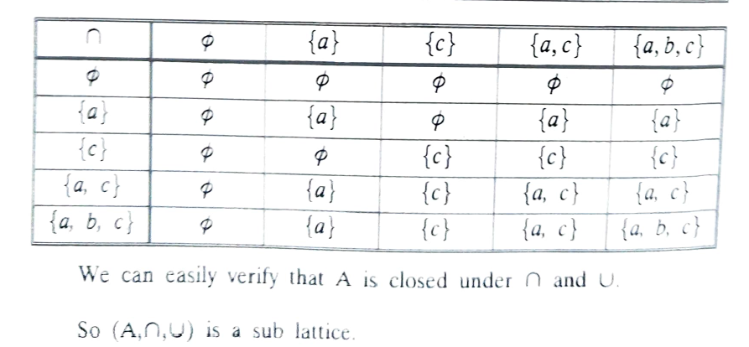
Sublattice - Example

Slide 48
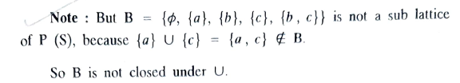
Note:

Slide 49

Special types of Lattices
Complete Lattice
A lattice $(L, ∨, ∧)$ is said to be complete if every non-empty subset has a least upper bound and a greatest lower bound.

Slide 50
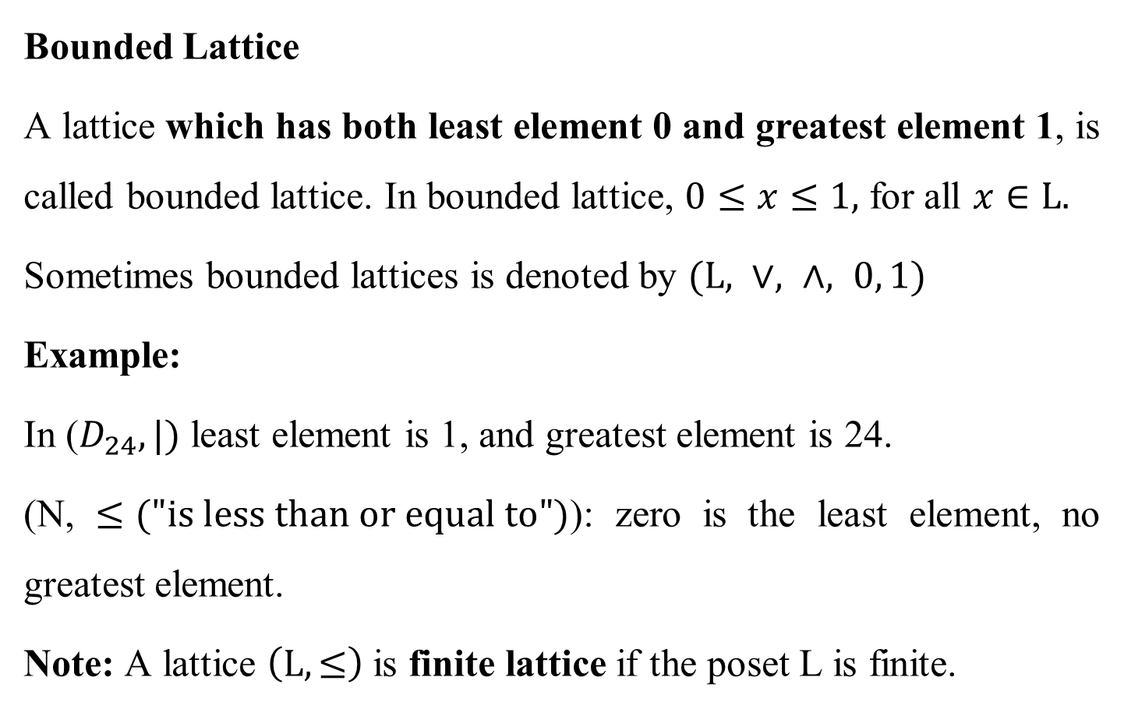
Special types of Lattices
Bounded Lattice
A lattice which has both least element 0 and greatest element 1, is called bounded lattice. In bounded lattice, $0≤x≤1,$ for all $x∈L.$
Sometimes bounded lattices is denoted by $(L, ∨, ∧, 0, 1)$
Example:
In ($D_{24},|)$ least element is 1, and greatest element is 24.
(N, $≤("is less than or equal to")$): zero is the least element, no greatest element.
Note: A lattice $\left(L, ≤\right)$ is finite lattice if the poset L is finite.

Slide 51

Special types of Lattices
Complement of an element
Let $(L, ∨, ∧, 0, 1)$ be a bounded lattice. An element $b∈L$ is called a complement of an element $a∈L$ if $a∧b=0$ and $a∨b=1.$
Hence $b=\overline{a}$ or $b=a′$

Slide 52


Special types of Lattices
Complemented Lattice
A bounded lattice $(L, ∨, ∧, 0, 1)$ is said to be complemented if every element of $L$ has atleast one complement.

Slide 53


Theorem
In a complemented, distributive lattice, show that the following are equivalent
$$a≤b ⟺a∧\overline{b}=0 ⟺\overline{a}∨b=1 ⟺\overline{b}≤\overline{a}$$

Slide 54

Theorem
In a complemented, distributive lattice, show that the following are equivalent
$$a≤b ⟺a∧\overline{b}=0 ⟺\overline{a}∨b=1 ⟺\overline{b}≤\overline{a}$$

Slide 55

Theorem
In a complemented, distributive lattice, show that the following are equivalent
$$a≤b ⟺a∧\overline{b}=0 ⟺\overline{a}∨b=1 ⟺\overline{b}≤\overline{a}$$

Slide 56


Theorem
In a complemented, distributive lattice, show that the following are equivalent
$$a≤b ⟺a∧\overline{b}=0 ⟺\overline{a}∨b=1 ⟺\overline{b}≤\overline{a}$$
Thus
$$a≤b ⟺a∧\overline{b}=0 ⟺\overline{a}∨b=1 ⟺\overline{b}≤\overline{a}$$

Slide 57

De Morgan’s laws
If $(L, ∧, ∨)$ be a complemented, distributive lattice, then for any $a,b∈L,$ ${{\left(a∨b\right)}^{′}=a^{′}∧b^{′} and \left(a∧b\right)}^{′}=a^{′}∨b^{′}$
Proof: Given $(L, ∧, ∨)$ is a complemented, distributive lattice. $∴$ every $a∈L$ has unique complement $a′$.
Then $a∧a^{′}=0,$ $a∨a^{′}=1$ ----------------(1)
Let $a,b∈L$ be any two elements.
To prove ${\left(a∨b\right)}^{′}=a^{′}∧b′$

Slide 58

De Morgan’s laws
We have to prove that the complement of $a∨b$ is $a^{′}∧b′$
ie to prove that $\left(a∨b\right)∨\left(a^{′}∧b^{′} \right)=1$ and $\left(a∨b\right)∧\left(a^{′}∧b^{′} \right)=0$
Now $\left(a∨b\right)∨\left(a^{′}∧b^{′} \right)=\left[\left(a∨b\right)∨a′\right]∧\left[\left(a∨b\right)∨b′\right]$
$=\left[a∨(b∨a^{′})\right]∧\left[a∨(b∨b^{′})\right]$
$=\left[a∨(a′∨b)\right]∧\left[a∨1\right]$
$=\left[(a∨a′)∨b\right]∧1$
$=\left[1∨b\right]∧1$
$=1∧1=1$ ----------------(2)

Slide 59

De Morgan’s laws
a$nd \left(a∨b\right)∧\left(a^{′}∧b^{′} \right) =\left[a∧\left(a^{′}∧b^{′}\right)\right]∨\left[b∧(a^{′}∧b^{′})\right]$
$=\left[\left(a∧a^{′}\right)∧b′\right]∨\left[\left(b∧a^{′}\right)∧b′\right]$
$=\left[0∧b′\right]∨\left[\left(a′∧b\right)∧b′\right]$
$=0∨\left[a^{′}∧(b∧b^{′})\right]$
$=0∨[a^{′}∧0]$
$=0∨0=0$ ----------------(3)
Thus we have $\left(a∨b\right)∨\left(a^{′}∧b^{′} \right)=1$
$$\left(a∨b\right)∧\left(a^{′}∧b^{′} \right)=0$$

Slide 60

De Morgan’s laws
Hence the complement of $\left(a∨b\right)$ is $\left(a^{′}∧b^{′} \right)$
$$⟹{\left(a∨b\right)}^{′}=a^{′}∧b′$$
By duality we get ${\left(a∧b\right)}^{′}=a^{′}∨b′$

